Slide 1

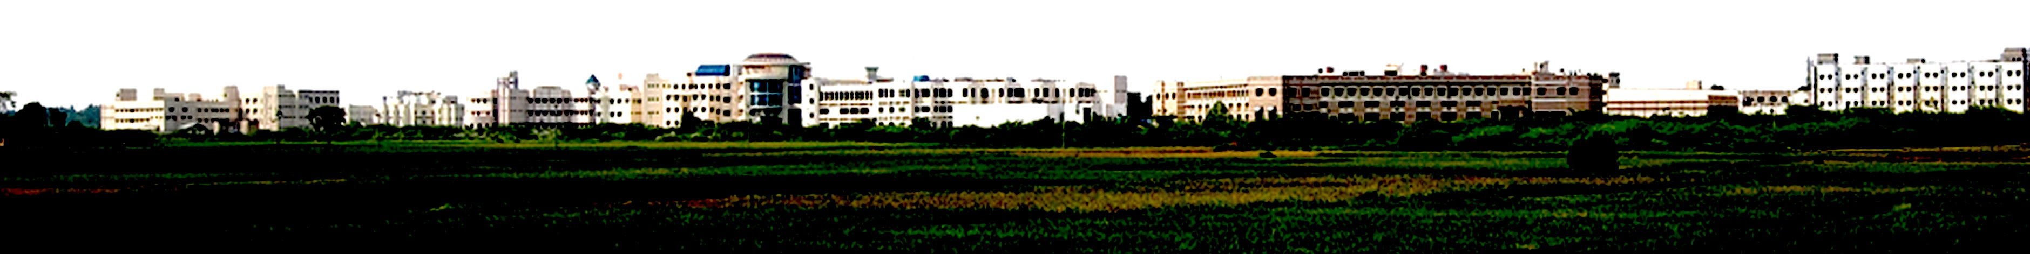
HARDWARE IMPLEMENTATION OF LOSSLESS IMAGE COMPRESSION
Presented by:
Abhishek S R (127160049)
Deepan Raj K (127004058)
Vidhya Vinayaga K G (127004298)
Department of ECE
School of EEE
Mentor:
Dr. Siva J

Slide 2

Motivation
The Problem: Data Overload
Modern imaging systems, from surveillance cameras to autonomous vehicles and medical devices, generate high-resolution image data at very high rates.
Increased bandwidth requirements
High memory usage
Latency during transmission and storage
Traditional software-based lossless compression methods are not optimized for real-time hardware execution.
Our Solution: Hardware Acceleration
This project aims to deliver a low-latency, lossless image compression solution specifically designed for hardware.
Hardware-friendly algorithms suitable for FPGA
Deterministic and parallel processing capability
Our objective is to design and implement a hybrid predictive lossless image compression algorithm, fully realized in Verilog, capable of real-time operation on FPGA hardware.

Slide 3
Literature survey
S.NO | PAPER TITLE/YEAR | KEY CONTRIBUTION | LIMITATION
1 | A FPGA implementation scheme for JPEG‐LS lossless compression based on frame difference method 2025 | Qi Liu, Ming Liu, Xiaojie Tong, Chen Yang | Does not handle noisier components/trap unit
2 | Parallel Lossless Compression of Raw Bayer Images on FPGA-Based High-Speed Camera 2024 | Žan Regoršek ¹, Aleš Gorkič ², Andrej Trost ^{1,} | Only applied to bayer images not grayscale/RGB
3 | Lossless Compression Algorithm and Architecture for Reduced Memory Bandwidth Requirement with Improved Prediction Based on the Multiple DPCM Golomb-Rice Algorithm 2021 | Imjae Hwang, Juwon Yun, Woonam Chung, Jaeshin Lee, Cheong-Ghil Kim, Youngsik Kim, Woo-Chan Park | Uses multiple DPCM predictors but not MED predictor
4 | IMPLEMENTATION OF LOSSLESS IMAGE COMPRESSION USING FUZZY BASED MODIFIED GOLOMB RICE ENCODING 2023 | MD .SANA NOUSHEEN, T.VIJAY KUMAR | More complex hardware

Slide 4
Abstract
● This project focuses on designing a lossless image compression system for hardware implementation.
● Hardware-based compression enables real-time processing with low latency.
● It also offers higher throughput compared to software-based solutions. ● The proposed method uses predictive coding to estimate pixel values efficiently.
● Each pixel is predicted using its neighboring pixels.
● Only the difference between the actual and predicted pixel is encoded. ● These prediction errors are generally small in magnitude.
● The errors are mapped to non-negative values for efficient encoding.
● Golomb–Rice entropy coding is used to compress the error values.
● The encoder is implemented using Verilog HDL for parallel execution.
● A software decoder is used only for functional verification.
● The system achieves pixel-perfect reconstruction with low hardware complexity.

Slide 5
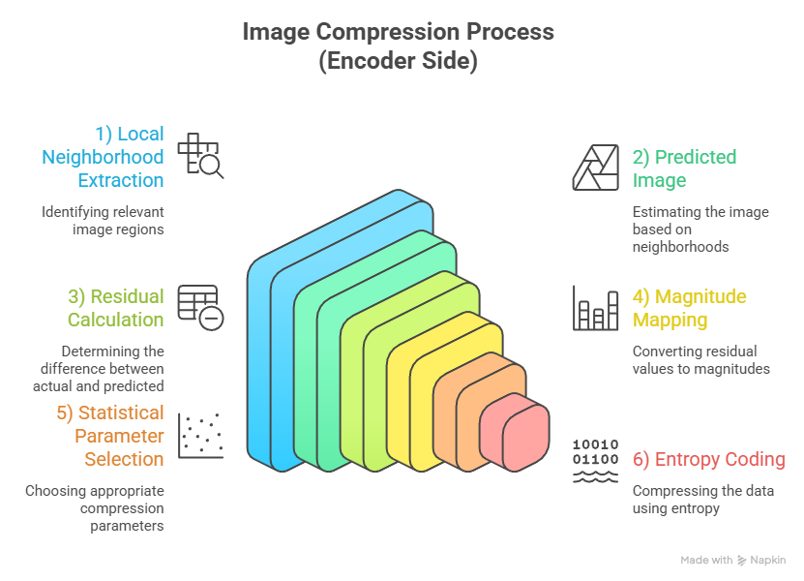
Block Diagram

Slide 6
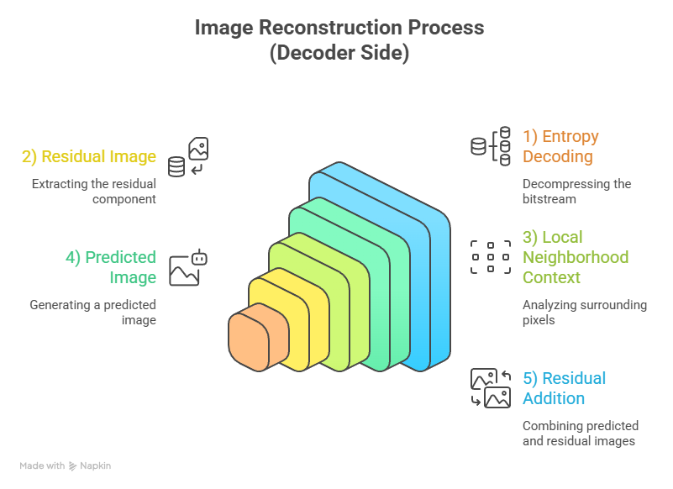
Block Diagram

Slide 7
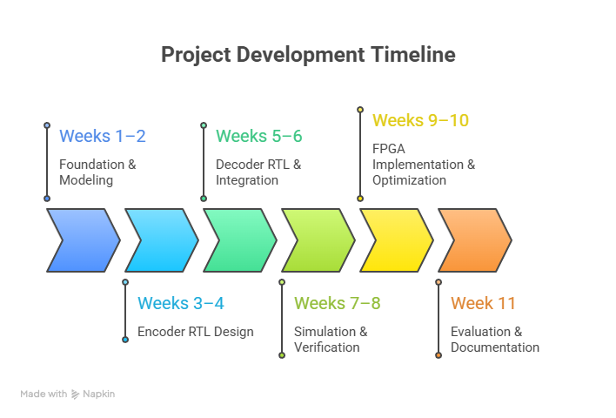
Time Line

Slide 8
THANK YOU

